Slide 1

Home loan approval prediction using machine learning models.
Khagendra Khati
Anderson College of Business and Computing, Regis University
MSDS692 Data Science Practicum-I
Professor Dr. Kellen Sorauf
March 5, 2023

Slide 2

Introduction
The purpose of this project is to predict the home loan approval of the client.
Company or bank wants to automate the loan eligibility process (real-time) based on customer details provided while filling out the application form. These details are Gender, Marital Status, Education, Number of Dependents, Income, Loan Amount, Credit History, and others.
This project has taken the data of previous customers of various banks to whom loans were approved on a set of parameters. So, the machine learning model is trained on that record to get accurate results.

Slide 3
Table of content
Understanding and loading the data
Missing value and outlier treatment
Exploratory Data Analysis
Model building: Apply ML classification algorithms.
Hyperparameter Optimization.
Result in visualization and presentation.

Slide 4
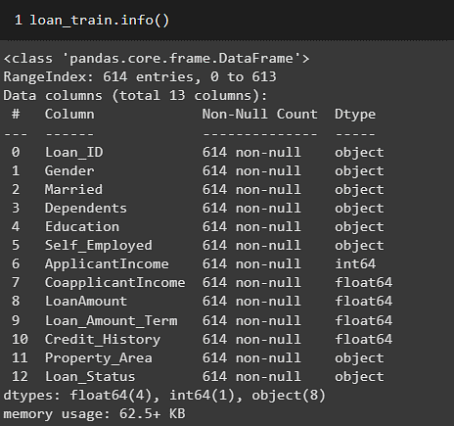
Understanding and loading the data
The dataset is taken from Kaggle: https://www.kaggle.com/datasets/rishikeshkonapure/home-loan-approval
Dataset consists of both categorical and numeric variables with 614 rows and 13 features, which were further split into 80:20 ratios for train and test datasets.
Categorical features are Gender, Married, Self_Employed, Credit_History, and Loan_Status) and numerical features are ApplicantIncome, Co-applicant income, LoanAmount, Loan_Amount_Term

Slide 5
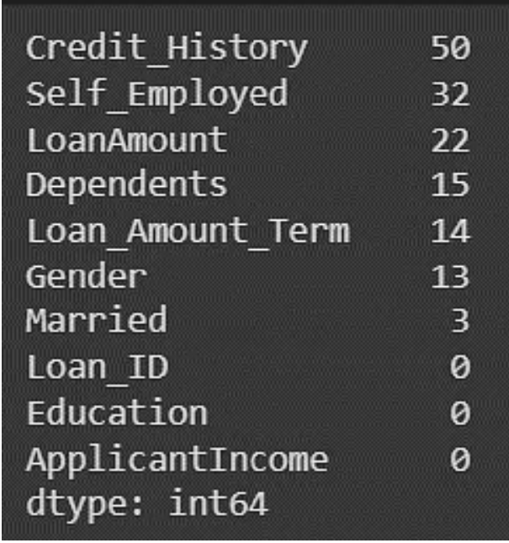
Missing value and outlier treatment
There are a few missing values in the Gender, Married, Dependents, Credit_History, and Self_Employed features so we can fill them in using the median value of the features.
We completed handling all the missing values, converted all the categorical variables into numeric values, and normalized the data.

Slide 6
Exploratory Data Analysis
Exploratory data analysis is an approach to analyzing data using visual techniques.
It is used to discover trends, and patterns, or to check assumptions with the help of statistical summaries and graphical representations.
The importance of EDA is,
It helps identify errors in data sets.
It gives a better understanding of the data set.
It helps detect outliers or anomalous events.
It helps understand data set variables and the relationship among them.

Slide 7
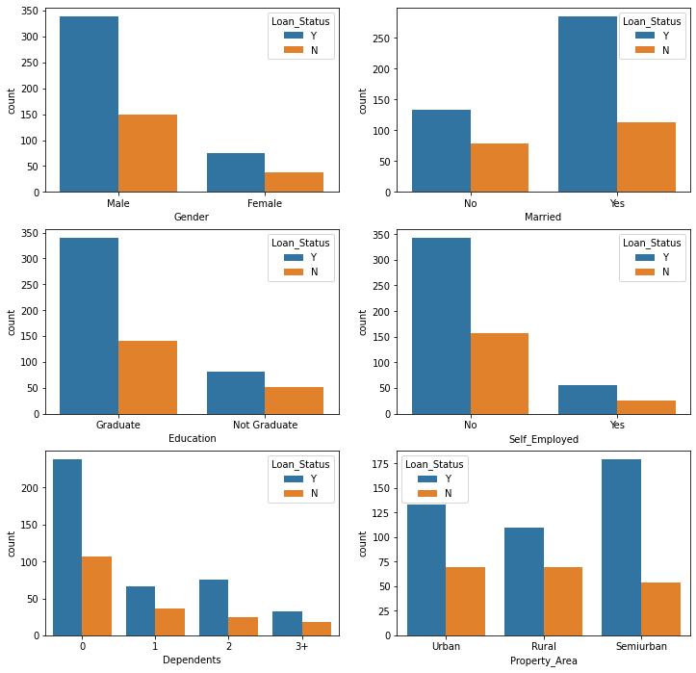
Bar plot
We can see that people who haven't graduated are far less likely to have their loans approved.
Chances of loan approval are high in, married compared to unmarried.
Chances of loan approval are high having zero dependents.

Slide 8
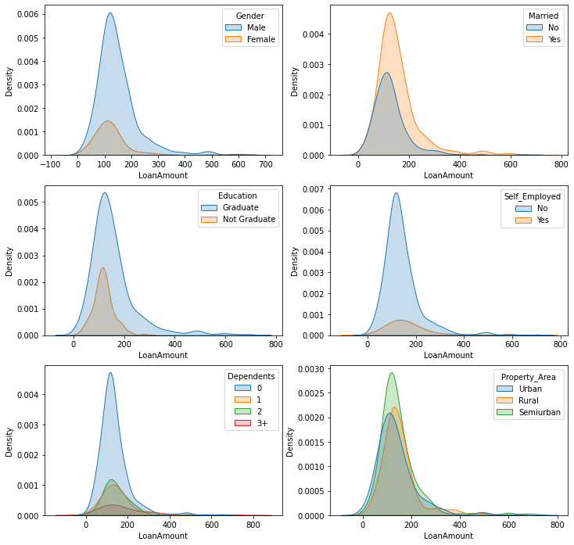
Pairplot
This plot depicts the amount of loan able to get depending on different variables. Here we can see that married, graduated, not self-employed, no dependents, a male who lives in a semi-urban area are able to get high loan amount.

Slide 9
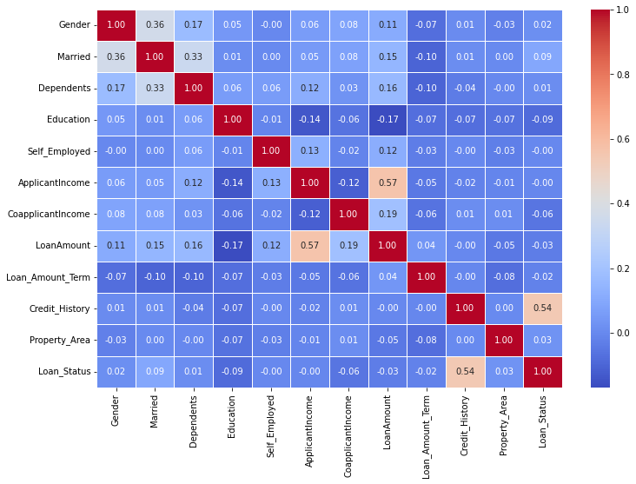
Heatmap
Heatmap is used to analyze the relationship between different variables.
From the given heatmap, we can see it is a significant correlation between loan status and credit history and loan amount and applicant income.

Slide 10
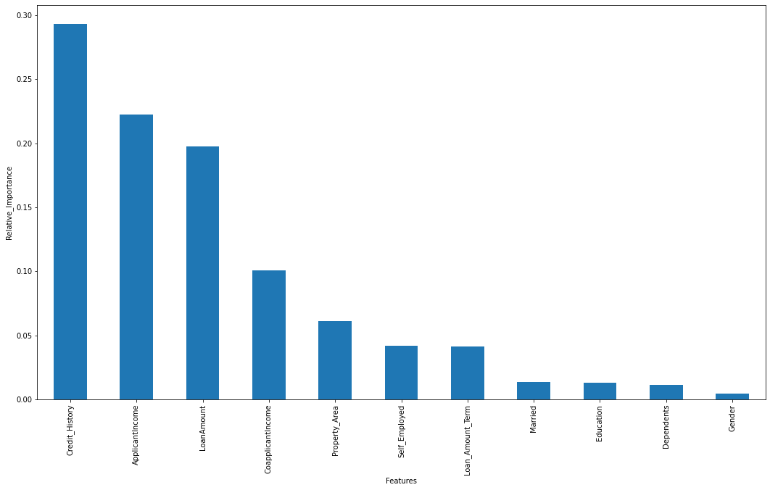
Feature Importance
Feature Importance is the technique that calculates a score for all the input features for a given model. A higher score means that the specific feature will have a larger effect on the model that is being used to predict a certain variable.
Given plot depicts that credit history, applicant income and loan amount have a high importance and effect on predicting loan approval.

Slide 11
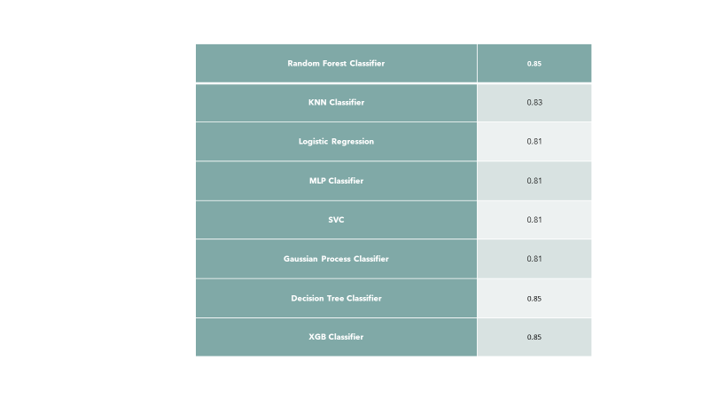
Results
For predicting loan approval, We implemented various machine learning classifier models.
Random Forest, Decision Tree, and XGB Classifiers performed best with the highest accuracy .

Slide 12
Conclusions
After understanding and loading the data, treating missing values, completing exploratory data analysis, and implementing different machine learning models, we concluded that,
The Loan approval and Rejection pattern are nearly the same in all three Property Areas(Urban, Semi-Urban, and Rural Areas).
Chances of loan approval for higher amounts increase with the increase in the total income of the applicant(s).
Credit History has a significant impact on loan approval
Implementing some machine learning models, we achieved the highest accuracy from Random Forest Classifier, Decision Tree Classifier, and XGB Classifier
We also performed hyperparameter tuning using Grid Search CV on Random Forest. Decision Tree and XGBOOSt algorithms achieved more accuracy than the previous model i.e 86%.

Slide 13


